Slide 1
Today
Our Equality, Inclusion and Diversity approach
Conversations (25 mins)
Break (5 mins)
People at the heart of decision making
Conversations (25 mins)
Keeping in touch

Slide 2
Our new approach Equality, Diversity and Inclusion
EDI@sportscotland.org.uk

Slide 3
New EDI approach
Notes:
We are in the process implementing a new approach to EDI.
What’s not new is our vision of an active Scotland where everyone benefits from sport. And what’s not new is out commitment to inclusion underpinning everything we do.
What is new are these three strands of work. We’ve adopted these because we want sport to be inclusive by design and we want to help us all experience the benefits of equality.
This is transformational, systemic change
Tools, 54% Debias, Experiment

Slide 4
Share:
our new approach to Equality, Diversity and Inclusion (EDI)
learning from our Equality Outcomes public consultation
how we’ll deliver the outcomes
Purpose: Your feedback will inform the develop of new EDI resources for the sector

Slide 5
New ideas are outcome driven
NEW IDEAS
We experiment and co-design new approaches that respond to the needs of disadvantaged and excluded groups.

Slide 6
New ideas are outcome driven
We will help people who:
Live in poverty and low income | Experience mental health problems
Are over 50 years old | Are part of our diverse ethnic communities
To feel:
I see and hear people like me taking part
I have a voice in the decisions that affect me
I feel like taking part is for me
I can find opportunities that meet my needs
Notes:
They address common experiences shared by the four groups. These shared themes and experiences are rooted in their under-representation in sport.
People are complex. Each of the groups are diverse. The characteristics and experiences within each group also overlap. Looking at common themes helps us navigate this.
They are high level and person-centred. This is about giving space – to co-create solutions and to understand needs.

Slide 7
Why these groups?
Those who are underrepresented in sport are also more likely to be affected by poverty and low income.
There is a spectrum of mental health. But we know that people with severe and enduring mental health problems tend to be most excluded from taking part. We want to better meet their needs.
The drop in sport participation in older age begins around 50 and continues. We are an aging population and we have more to learn about the needs of people in older age and how they want to take part.
We know that the population who participate in sport are not ethnically diverse and doesn’t reflect our wider communities and populations. We think it should.
Notes:
Population structure, Gaps in our learning, Impact of Covid
Consultation voices

Slide 8
Why these outcomes?
To feel:
I see and hear people like me taking part
I have a voice in the decisions that affect me
I feel like taking part is for me
I can find opportunities that meet my needs
Notes:
Common experiences that are the result of under-representation

Slide 9
Why these outcomes?
Visibility and representation
I don't see or hear about people like me taking part. I feel excluded because there is a dominant group in sport – it feels like their space, not mine. People make assumptions about me based on stereotypes.
How I feel
It's daunting to start or to get back in to sport. I'm anxious. I don't feel safe. I don't feel confident. I don't have the motivation. I've had bad experiences. I'm nervous about new people and experiences.
The offer
The offer isn't right for me. Cost and transport are barriers. It is not offered in places I would go to or at the times I am free. I'm concerned about amenities like changing rooms and toilets.
Design and decisions
I don't have a voice in how sport is run. My needs aren't reflected. I'm not asked about what matters to me. I'm not involved in decisions. I don't have any connection with decision makers.

Slide 10
Protected characteristics
(Age, disability, gender reassignment, race, religion or belief, sex, sexual orientation)
Notes:
Only one part of our approach to EDI
Age, disability, gender reassignment, marriage or civil partnership status, pregnancy and maternity, race, religion or belief, sex, sexual orientation

Slide 11
Working together
Listen and ask
Language
Be gentle
It’s ok to step off the call, or turn the camera off
Confidentiality and recording
This is a space to talk in whatever words you currently know. It doesn’t matter if you use awkward or dated language.
The important thing is that you start to explore openly what’s on your mind as regards the topic.

Slide 12
Working together
Groups of 5.
Share your reactions to what you’ve heard.
What are your hopes for this approach?
What are you not sure about?
What questions does this leave you with?
Purpose: Your feedback will inform the develop of new EDI resources for the sector

Slide 13
Working together
Cara Viola
EDI@sportscotland.org.uk

Slide 14
Break time! 11:50 – 11:55
The main session will restart at:11:55

Slide 15
People at the heart of decision making
New Ideas

Slide 16
People at the heart of decision making
Delivering our "New Ideas"
is about putting people at the heart of decision-making
Notes:
Talk about what happens in practice

Slide 17
“Nothing for us, without us. Conversations, engagement and listening and understanding is crucial.”
“The people who have the lived experience must be round the table too.”
“We are not diverse as a sporting sector - but we can be proactive in creating environments to listen and understand. Partnerships with community based (and non-sporting) groups from multiple ethnic backgrounds essential.”
Equality Outcomes Consultation
Notes:
Thinking was reinforced through the consultation

Slide 18
New ideas are outcome driven
NEW IDEAS
We experiment and co-design new approaches that respond to the needs of disadvantaged and excluded groups.

Slide 19
Lets explore this idea of involvement together now, so
-we understand this better
-we can put this into practice together
Purpose: Your views and experience will inform our approach to involvement and how we work together.
Notes:
Signpost

Slide 20
What is it?
Participatory
Service user involvement
Engagement
Consultation
Experts
by experience
Co creation
Voices
Co production
Co design

Slide 21
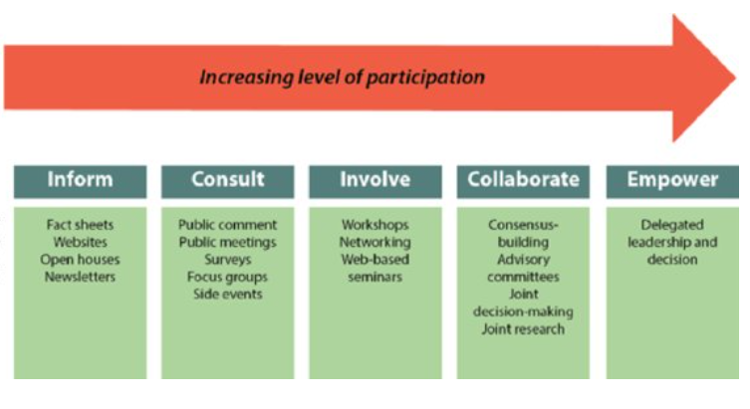
What is it?

Slide 22
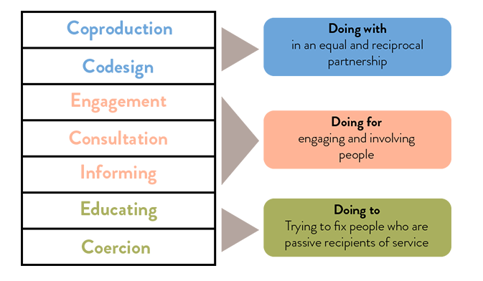
What is it?
Notes:
Source: Coproduction and service user involvement — NCVO Knowhow

Slide 23
What is it?
Co-production is where professionals and citizens share power to plan and deliver support services together, recognising that both partners have a vital contribution to make.

Slide 24
What is it?
Coproduction refers specifically to work with people with lived experience of the service or policy in question, rather than any citizen.
Co-creation or co-design, where people are involved in coming up with ideas, is not full coproduction but may be a step on the road to embedding coproduction in your way of working.
Source: Coproduction and service user involvement — NCVO Knowhow
Notes:
Source: Coproduction and service user involvement — NCVO Knowhow

Slide 25
Why do this?
Involving people who use services in the design and delivery of services can increase your impact.

Slide 26
Why do this?
Notes:
Social issues solved better

Slide 27
SafeLives is a UK-wide charity dedicated to ending domestic abuse, for everyone and for good.
Survivors of abuse
“should feed into decisions because they are the experts by experience… by gathering the experience of survivors and understanding their reality an appropriate and realistic response can be formulated.”
Notes:
Why doesn’t she leave? TO Why don’t they stop?
Survivors at the centre
Why doesn’t she leave? TO Why don’t they stop?

Slide 28
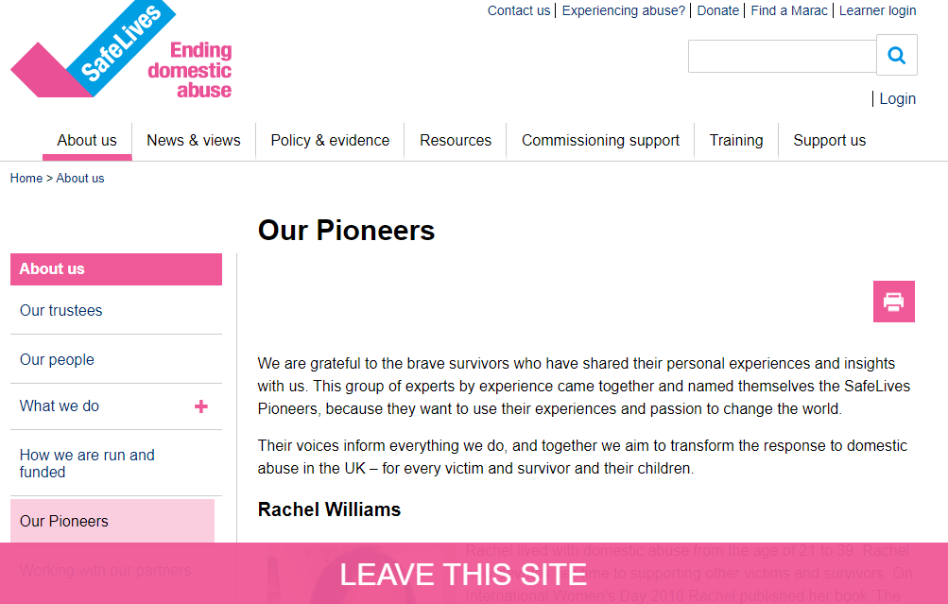
Notes:
Why doesn’t she leave? TO Why don’t they stop?

Slide 29
Conversations
In groups of 5
Practitioners views, opinions and experience
Have you ever been involved as a citizen or service user?
What are your views or opinions on involvement?
Have you any experience of doing this?
Do you work with under-represented or excluded groups - How would they want to get involved?

Slide 30
How are you feeling now?
Please put a few words in the chat ☺
Notes:
Happy, angry, excited, confused, energised, tired

Slide 31
Keeping in touch
EDI@sportscotland.org.uk
Your input will help us develop:
EDI resources for the sector
our involvement approach
We email a feedback form and keeping in touch information next week
Updates website with today’s slides and next steps

Slide 32
Thank you
EDI@sportscotland.org.uk

Slide 33
New ideas timeline
Onwards to 2025
Outcomes 2021-25
published
June - July
August–November
Understanding needs
and
building New Ideas Action Plan
Share consultation findings
April
Develop involvement approach
Notes:
For those of you who are joining the conversation for the first time – welcome – this is a great time to get involved!
For those who have already been involved – thanks for all the experiences and views you have shared so far.

Slide 34
We won't give up until everyone experiencing a mental health problem gets support and respect.
When mental health services were co-produced, those services were more effective for the people using them.
They experienced:
An improved sense of belonging to local groups and networks.
Reduced stigma.
Increased skills and employability. Co-production meant people were able to improve skills, engage with formal learning and training opportunities and gain longer-term employment. People involved in the Expert Patient Programme reported a 24% increase in paid employment.
Improving physical and mental well-being. This was the strongest theme that emerged. We found that interventions shaped by co-production had a powerful impact on people’s sense of competence, autonomy and relatedness, and on their personal, social and emotional capabilities. These are all fundamental to our ability to experience positive life outcomes and to maintain and grow our well-being.
Notes:
Person at the centre of their purpose

